Slide 1
High Temperature Characterization of Electroless Tribological Coatings
Mid-semester evaluation of M.Tech project
Aman Kumar
Roll no. 2102103001, M. Tech (PIE)
Under The Supervision of
Dr. Satyajit Chatterjee
(Associate Professor)
Department of Mechanical Engineering
Indian Institute of Technology Indore
2022
Notes:
Development of Electroless Composite Coatings for High-temperature Tribological Applications

Slide 2
Electroless Coatings in Tribological Situations
Advantages
The ability to plate complicated and irregular shapes [1].
Ability to deposit on electrically non-conducting substrates [2].
Improved wear resistance due to a more consistent thickness [3].
Notes:
Electroless coating technique is a cost-effective way to synthesize thin layered material on a substrate, where combination of properties like sufficiently high hardness, low friction coefficient as well as good corrosion resistance can be achieved.

Slide 3
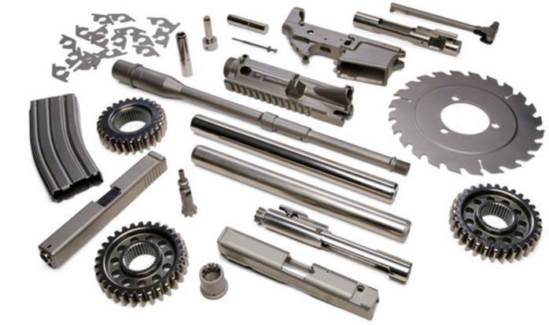
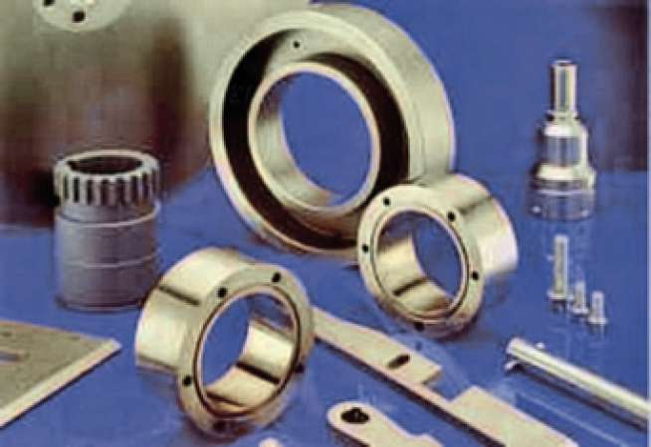
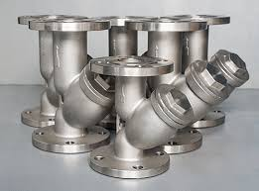
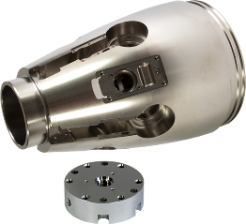
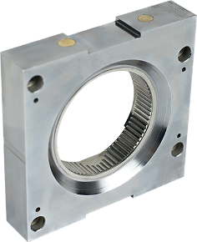
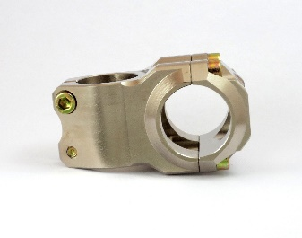
Industrial Applications of Electroless Coating
Industries | Applications
Aerospace | Compressor blades, Piston heads, Engine mounts, Bearing journals, etc;
Automotive | Gears & gear assemblies, Fuel injectors, Heat sinks, etc;
Chemical | Valves, Turbine and compressor blades, rotor assemblies, Spray nozzles, Filters and components etc;
Oil and Gas | Tubes, Pump housing, Sucker rods, threaded parts, Packers, etc;
Materials Handling | Hydraulic cylinders and shafts, Extruders, Gears and clutches, etc;
Electronic | Capacitors, Contacts (surface, sliding, pins & sockets), PWB-connectors, PWB-surface mounts, etc;
G.O. Mallory (1990)

Slide 4
hBN can sustain 1000°C
Incorporation of hBN as solid lubricant can be beneficial in terms of high temperature tribological applications [5]
Notes:
Here we can easily make a difference that hBN will be good for our project work.

Slide 5
Objectives
To fabricate the coatings.
To Incorporate hBN for better mechanical and tribological properties.
Characterization of the coatings.
To check high temperature suitability of the coatings.

Slide 6
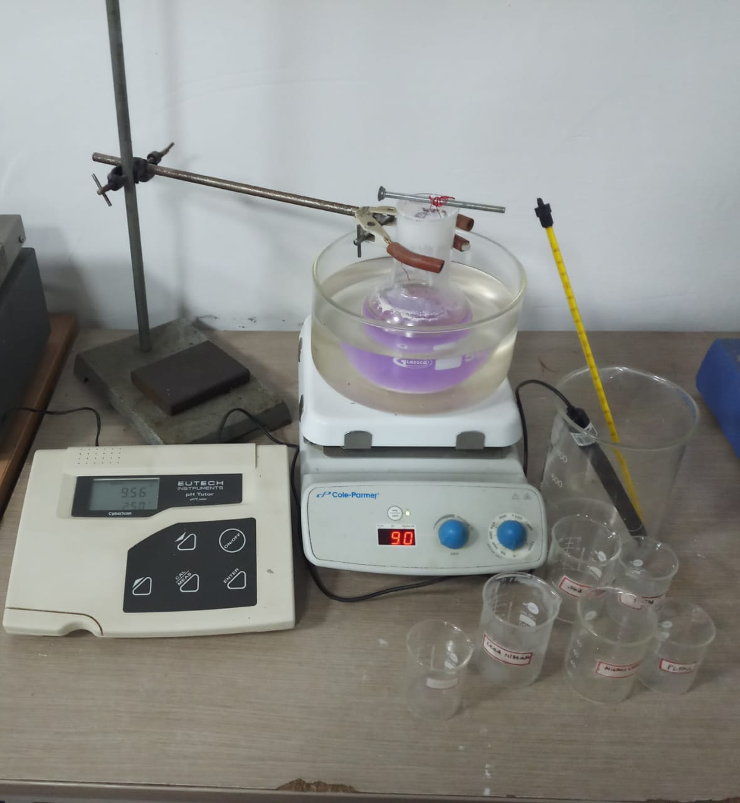
Set up for Deposition of Electroless Coating
Stand
Sample
Thermometer
Flat
bottom
flask
Silicon
Oil
Bath
Magnetic Stirrer
Speed (RPM) controller
Beakers
Temperature controller
pH Meter

Slide 7
Methodology
Preparation of substrate (grinding, polishing, degreasing)
Measurement of chemicals
Preparation of bath
Immersion of bath to develop coating
Thorough characterization of mechanical and tribological properties.

Slide 8
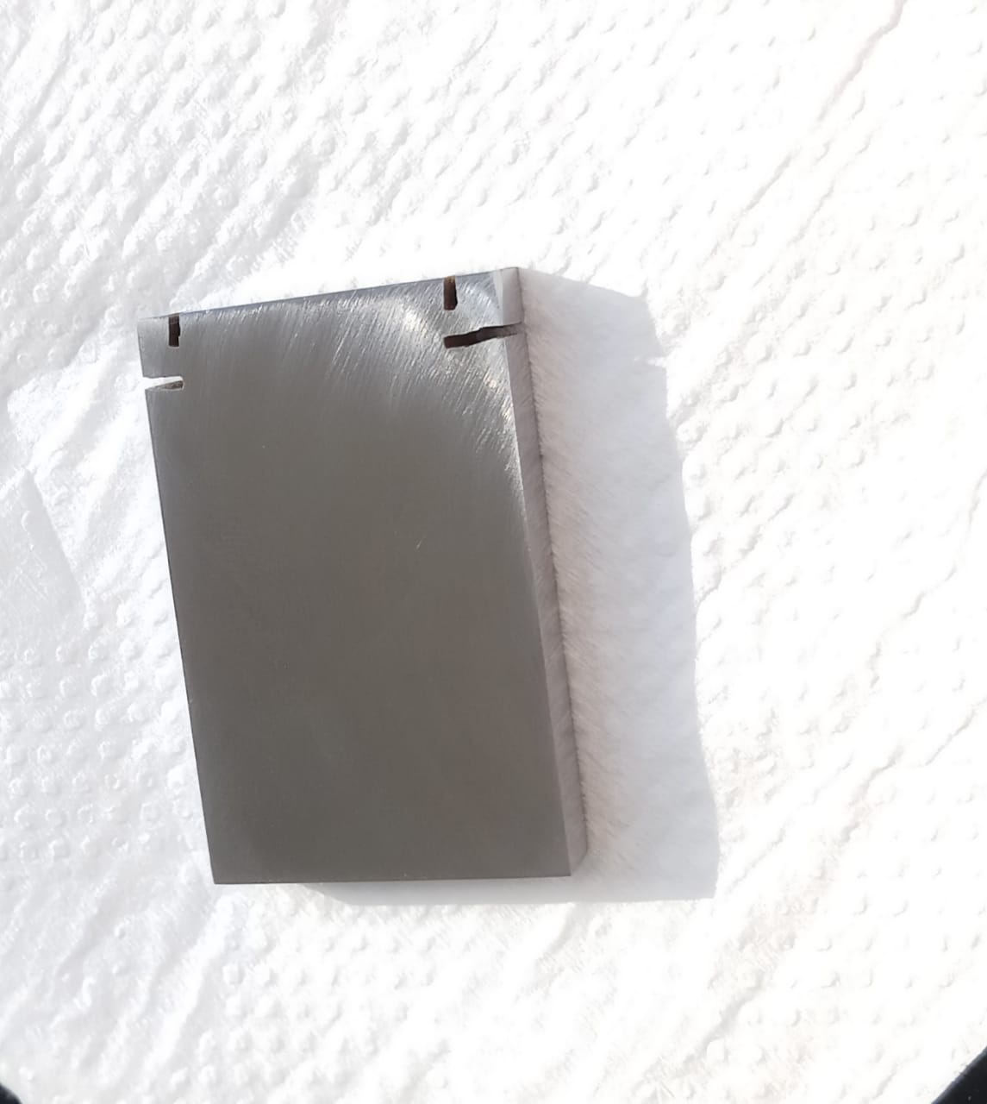
Uncoated Sample
Substrate Material: Steel AISI-1025
Substrate Dimensions: (30 mm × 20 mm × 5 mm)

Slide 9
Coatings Fabricated
1. Ni-B (Alloy Coating)
2. Ni-B-W (Alloy Coating)
3. Ni-B-W-hBN (Composite Coating)
Constituents | Ni-B | Ni-B-W | Ni-B-W-hBN
Nickel Chloride | 20 g/l | 20 g/l | 20 g/l
Sodium Hydroxide | 40 g/l | 40 g/l | 40 g/l
Sodium Borohydride | 0.8 g/l | 0.8 g/l | 0.8 g/l
Sodium Tungstate | ̶ | 25 g/l | 25 g/l
Ethylenediamine | 59 g/l | 59 g/l | 59 g/l
Lead Nitrate | 0.0175 g/l | 0.0175 g/l | 0.0175 g/l
hBN particles | ̶ | ̶ | 1 g/l
Plating Time | 3h | 3h | 3h
Bath pH | 13±2 | 13±2 | 13±2
Bath Temperature | 90±2°C | 90±2°C | 90±2°C
Tween-20 Surfactant | ̶ | ̶ | 0.045ml/l

Slide 10
Result and Discussion

Slide 11
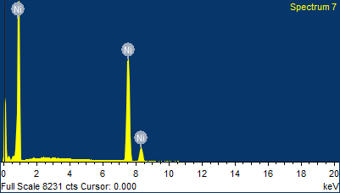
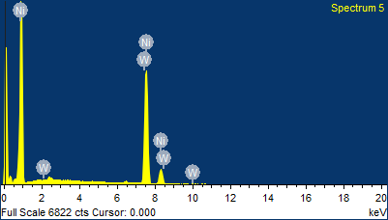
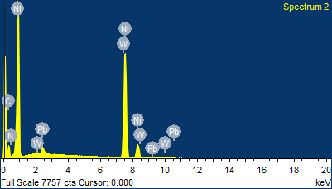
Surface Morphology and EDS
Ni-B
20µm
Ni-B-W
20µm
Ni-B-W-hBN
20µm

Slide 12
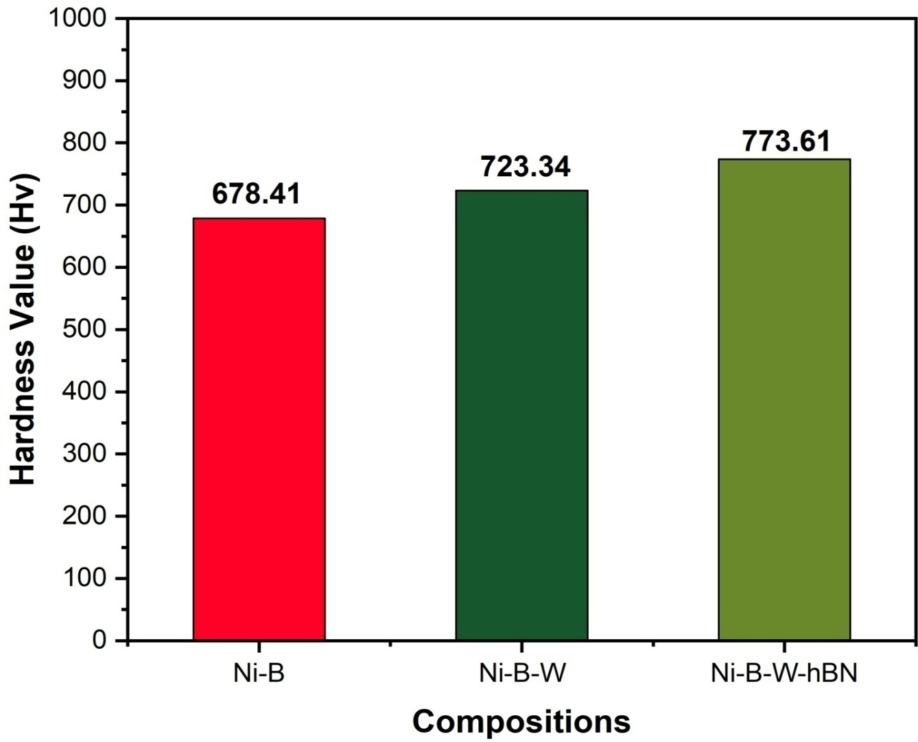
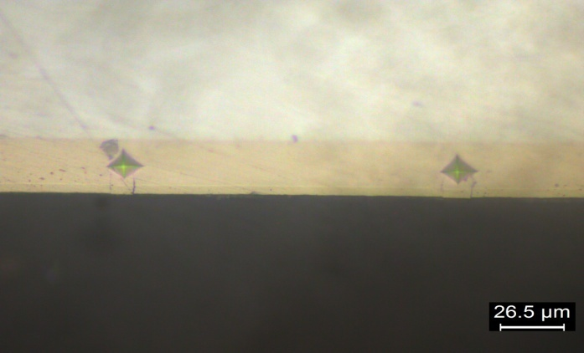
Micro Hardness Comparison
Parameters
Type Vickers hardness
Load 10g
Loading time 10s
Dual time 4s
Unloading time 10s

Slide 13
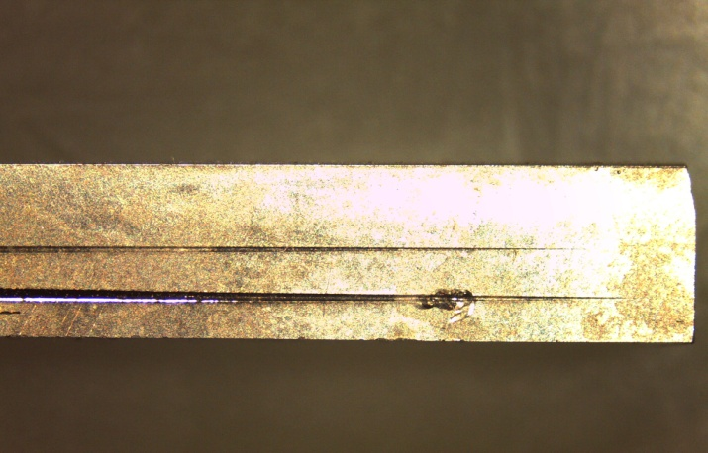
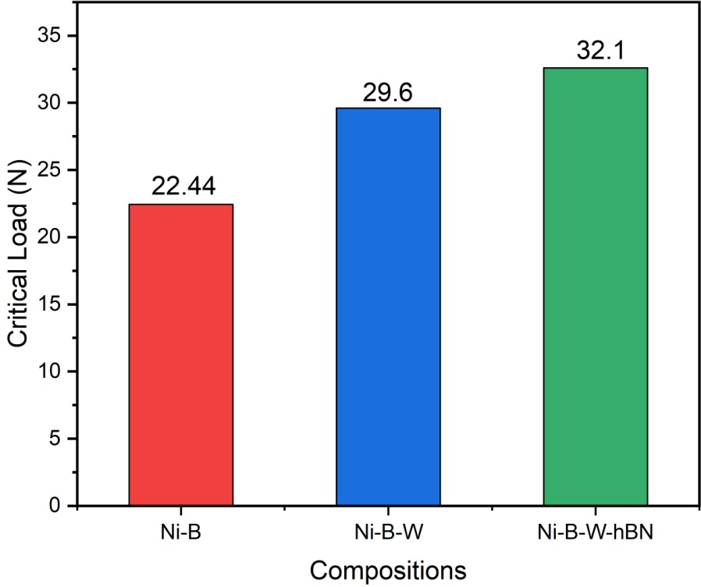
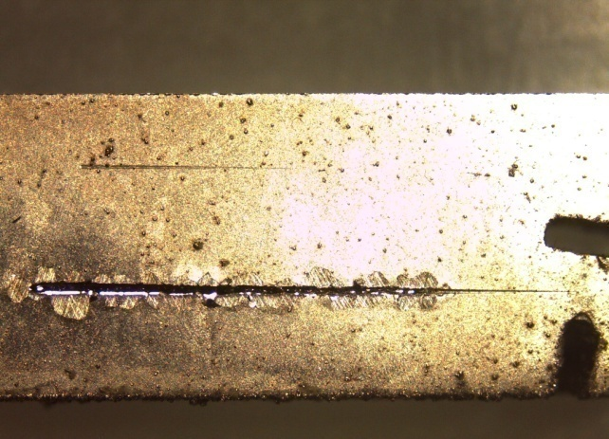
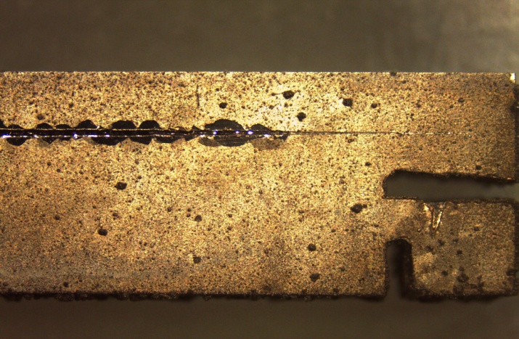
Scratch Test
Critical Load Comparison
Ni-B 22.44 N
Parameters
Load 0 to 45N
Loading rate 3N/mm
Ni-B-W 29.6 N
Ni-B-W-hBN 32.1 N

Slide 14
Scratch Hardness and Fracture Toughness
Input Parameter Variables
Compositions | Load | Scratch Speed
Ni-B | 14N | 1mm/s
Ni-B-W | 17N | 3mm/s
Ni-B-W-hBN | 20N | 5mm/s

Slide 15
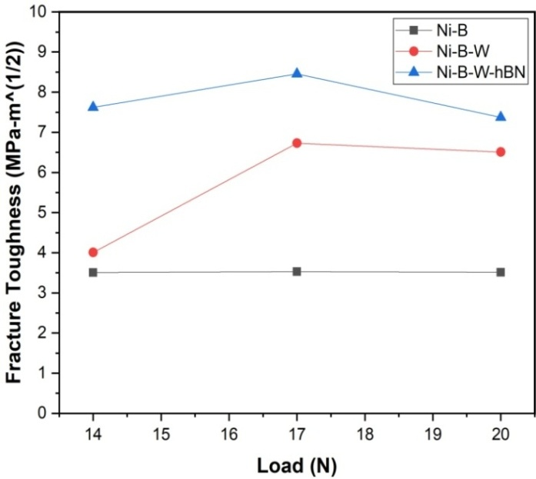
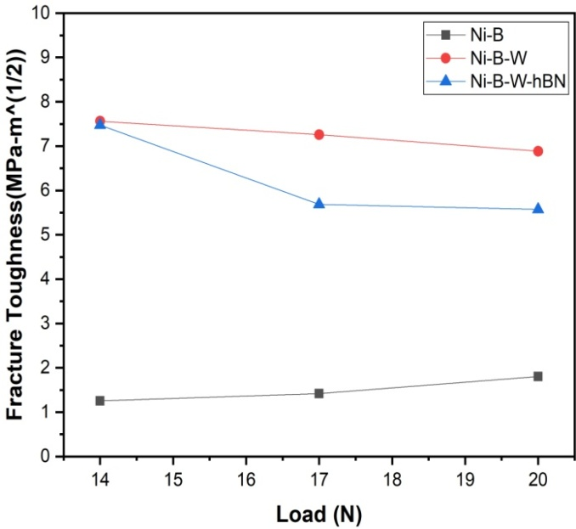
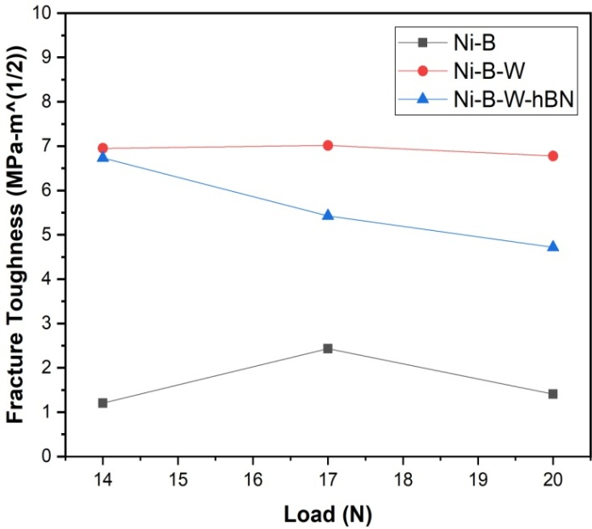
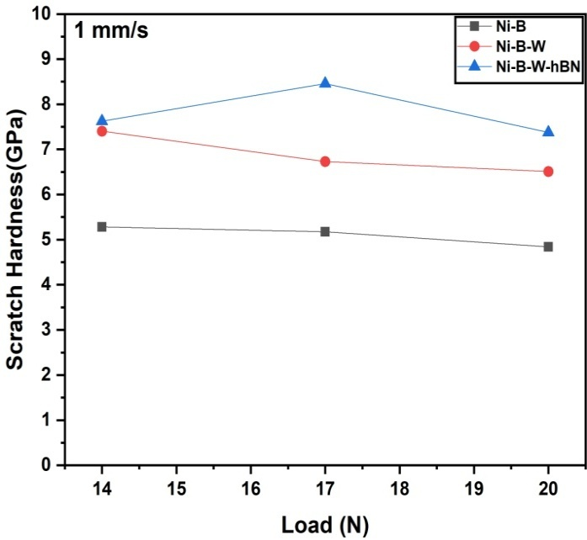
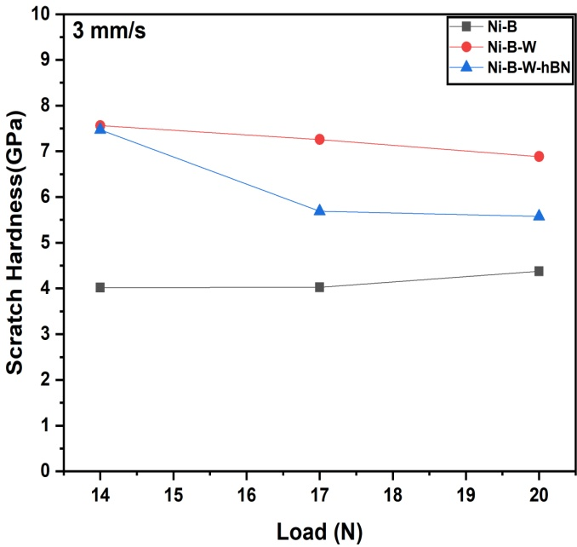
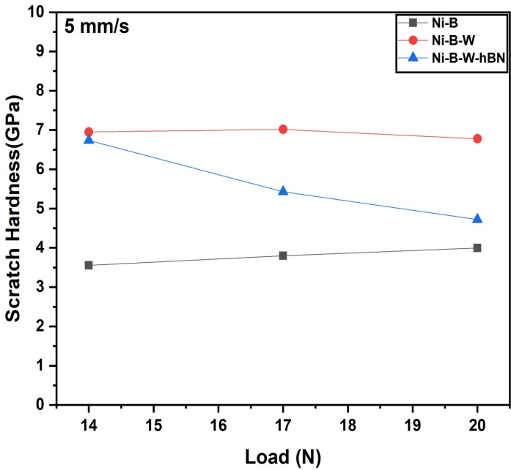
Scratch Hardness and Fracture Toughness Comparison
1 mm/s
3mm/s
5mm/s
1 mm/s
3mm/s
5mm/s

Slide 16
Conclusions
Addition of tungsten causes remarkable increment in Various mechanical and tribological properties such as hardness , critical load and fracture toughness of the coating.
And addition of hBN further improves the hardness , critical load and fracture toughness of the coating.

Slide 17
Future Plan
Now my future plan is to study the effectiveness of this composite coating, at higher temperature in two ways one by Ex-situ heat treatment and other by in-situ heat treatment testing and I will do comparison at both situation.
Phase 1 | Phase 2 | Phase 3 | Phase 4
Literature Review | Coating Fabrication (incorporation of hBN) | Tribological and Mechanical Properties Testing and Analysis (Ex situ Heat Treatment) | Comparison And Conclusion
Substrate Preparation | Tribological and Mechanical Properties Testing Analysis (As it is) | Tribological and Mechanical Properties Testing and Analysis (In situ Heat Treatment)

Slide 18
References:
Kerstin Kutschej, Christian Mitterer,* Christopher P. Mulligan and Daniel Gall High Temperature Tribological Behavior of CrN-Ag Self-lubricating Coatings ADVANCED ENGINEERING MATERIALS 2006, 8, No. 11
Robin Abraham Koshy 1,⁎, Michael E. Graham 2, Laurence D. Marks 3 Temperature activated self-lubrication in CrN/Mo2N nanolayer coatings R.A. Koshy et al. / Surface & Coatings Technology 204 (2010) 1359–1365
J.J. Hu *, C. Muratore, A.A. Voevodin Silver diﬀusion and high-temperature lubrication mechanisms of YSZ–Ag–Mo based nanocomposite coatings Composites Science and Technology 67 (2007) 336–347
N. Fateh ∗, G.A. Fontalvo, G. Gassner, C. Mitterer Inﬂuence of high-temperature oxide formation on the tribological behaviour of TiN and VN coatings Wear 262 (2007) 1152–1158
5. Jie Chen1 • Hui Song2,3 • Guang Liu1 • Bing Ma1 • Yulong An3 • Li Jia1 Cold Spraying: A New Alternative Preparation Method for Nickel-Based High-Temperature Solid-Lubrication Coating J Therm Spray Tech (2020) 29:1892–1901
Sunny Kumar, Tushar Banerjee , Dharmendra Patel Tribological characteristics of electroless multilayer coating: A review S. Kumar et al. / Materials Today: Proceedings xxx (xxxx) xxx
J.K. Pancrecious, S.B. Ulaeto, R. Ramya, T.P.D. Rajan, B.C. Pai, Int. Mater. Rev. 63 (2018) 488–512.

Slide 19
8. Yue Zhaoa,b, Kai Fenga,b, Chengwu Yaoa,b, Pulin Niea,b, Jian Huanga,b, Zhuguo Lia,b,c,⁎ Microstructure and tribological properties of laser cladded self-lubricating nickel-base composite coatings containing nano-Cu and h-BN solid Lubricants Surface & Coatings Technology 359 (2019) 485–494.
9. Min Hyung Cho a, Jeong Ju a, Seong Jin Kima,b, Ho Jang a, Tribological properties of solid lubricants (graphite, Sb2S3, MoS2) for automotive brake friction materials Wear 260 (2006) 855–860.
10. Kaline Pagnan Furlan, José Daniel Biasoli de Mello, Aloisio Nelmo Klein Self-lubricating composites containing MoS2: A review Tribology International S0301-679X(17)30591-1
Rahul Kumar 1,2,* , Irina Hussainova 1,* , Ramin Rahmani 1,3 and Maksim Antonov 1 Solid Lubrication at High-Temperatures—A Review Materials 2022, 15, 1695.
12. Rahul Kumar 1,2,* , Irina Hussainova 1,* , Ramin Rahmani 1,3 and Maksim Antonov 1 Solid Lubrication at High-Temperatures—A Review Materials 2022, 15, 1695.
13. Yue Zhaoa,b, Kai Fenga,b, Chengwu Yaoa,b, Pulin Niea,b, Jian Huanga,b, Zhuguo Lia,b,c,⁎ Microstructure and tribological properties of laser cladded self-lubricating nickel-base composite coatings containing nano-Cu and h-BN solid Lubricants Surface & Coatings Technology 359 (2019) 485–494.
14. Debjit Misraa, Vaibhav Nemanea, Suman Mukhopadhyayb, Satyajit Chatterjeea,∗ Eﬀect of hBN and SiC addition on laser assisted processing of ceramic matrix composite coatings Ceramics International 46 (2020) 9758–9764.
15. E. Ünala, İ.H. Karahanb,⁎ Production and characterization of electrodeposited Ni-B/hBN composite Coatings Surface & Coatings Technology 333 (2018) 125–137.

Slide 20
16. Avinandan Khaira a , Indrajit Shown b , Satyanarayana Samireddi c , Suman Mukhopadhyay d , Satyajit Chatterjee a, Mechanical and tribological characterization of deep eutectic solvent assisted electroless Ni–P-hBN coating Ceramics International xxx (xxxx) xxx
17. J.K. Pancrecious, S.B. Ulaeto, R. Ramya, T.P.D. Rajan, B.C. Pai, Int. Mater. Rev. 63 (2018) 488–512.
18. Sunny Kumar, Tushar Banerjee , Dharmendra Patel Tribological characteristics of electroless multilayer coating: A review Materials Today: Proceedings xxx (xxxx) xxx.
19. Prasanta Sahoo , Suman Kalyan Das Tribology of electroless nickel coatings – A review Materials and Design 32 (2011) 1760–1775.
20. J.N. BALARAJU1, T.S.N. SANKARA NARAYANAN2 and S.K. SESHADRI3 Electroless Ni–P composite coatings Journal of Applied Electrochemistry 33: 807–816, 2003.
21. K. Krishnavenia, T.S.N. Sankara Narayanana,*, S.K. Seshadrib Electroless Ni–B coatings: preparation and evaluation of hardness and wear resistance Surface & Coatings Technology 190 (2005) 115 – 121
22. Vaibhav Nemane Satyajit Chatterjee Scratch and Sliding Wear Testing of Electroless Ni–B–W Coating Journal of Tribology FEBRUARY 2020, Vol. 142 / 021705-1
23. IHSAN GÖKHAN SERIN EFFECT OF ANNEALING TEMPERATURE ON HARDNESS AND WEAR RESISTANCE OF ELECTROLESS Ni–B–Mo COATINGS Surface Review and Letters, Vol. 22, No. 5 (2015) 1550058 (9 pages)
24. T. SAITO, E. SATO*, M. MATSUOKAz, C. IWAKURAx Electroless deposition of Ni±B, Co±B and Ni±Co±B alloys using dimethylamineborane as a reducing agent JOURNAL OF APPLIED ELECTROCHEMISTRY 28 (1998) 559±563

Slide 21
25. Vaibhav Nemanea, Satyajit Chatterjeea,1 Nanomechanical, Tribological, and Scratch Properties of Electroless Ni-B-W Alloy and Ni-B-W-SiC Composite Coatings Journal of Tribology. Received June 28, 2021;
26. Vaibhav Nemane, Satyajit Chatterjee * Evaluation of microstructural, mechanical, and tribological characteristics of Ni-B-W-SiC electroless composite coatings involving multi-pass
Scratch test Materials Characterization 180 (2021) 111414
27. M. Ghaderia, M. Rezagholizadeha, *, A. Heidarya, and S. M. Monirvaghefib The Effect of Al2O3 Nanoparticles on Tribological and Corrosion Behavior of Electroless Ni–B–Al2O3 Composite Coating1 ISSN 2070-2051, Protection of Metals and Physical Chemistry of Surfaces, 2016, Vol. 52, No. 5, pp. 854–858.

Slide 22
Thank You

Slide 23
Engineering Application at High Temperature
Examples:
1. Metal Cutting.
2. Hot rolling.
3. Internal combustion engine etc.
Application of coatings
Protection from wear/friction
Protection from wear at higher temperature
Thermal barrier coating for rollers in hot rolling process
TiN coatings on cutting tools in conventional machining

Slide 24
Protection from Friction at High Temperature
Notes:
Is a bigger challenge and not very common to have lubricating effects maintained at higher temperature.
Are to be used to reduce friction but they do not last beyond a specific temperature
Liquid lubricants decompose
We require solid lub
Several solid lubricants have different temperature range

Slide 25
Ni-B-W-hBN
Ni-B-W-hBN

Slide 26
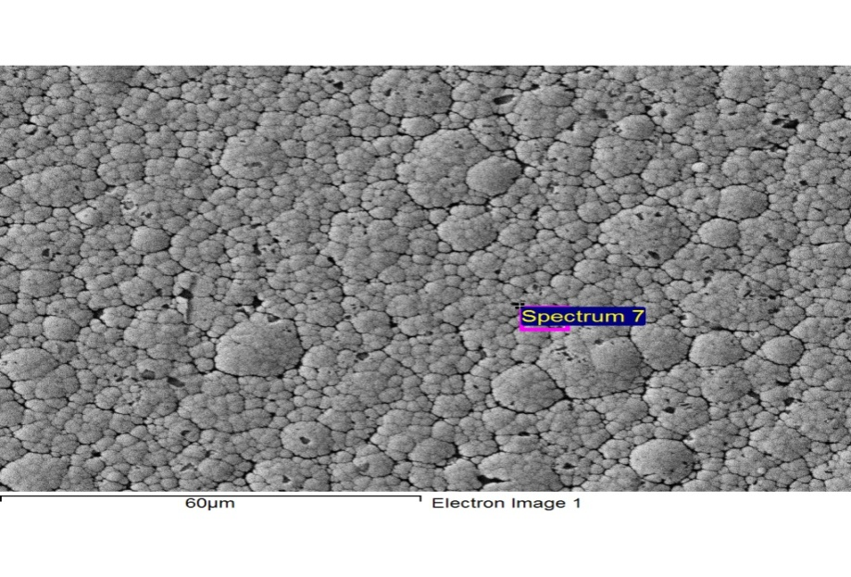
EDS Analysis : Ni-B
Element | Weight% | Atomic%
Ni K | 100.00 | 100.00
Totals | 100.00

Slide 27
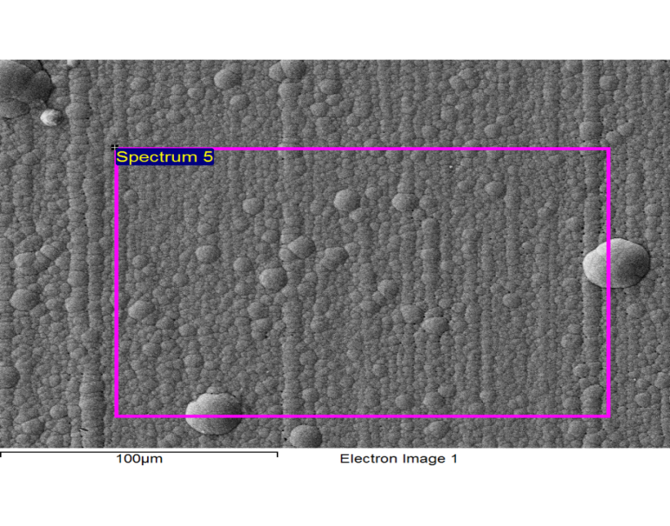
EDS Analysis : Ni-B-W
Element | Weight% | Atomic%
Ni K | 99.39 | 99.80
W M | 0.61 | 0.20
Totals | 100.00

Slide 28
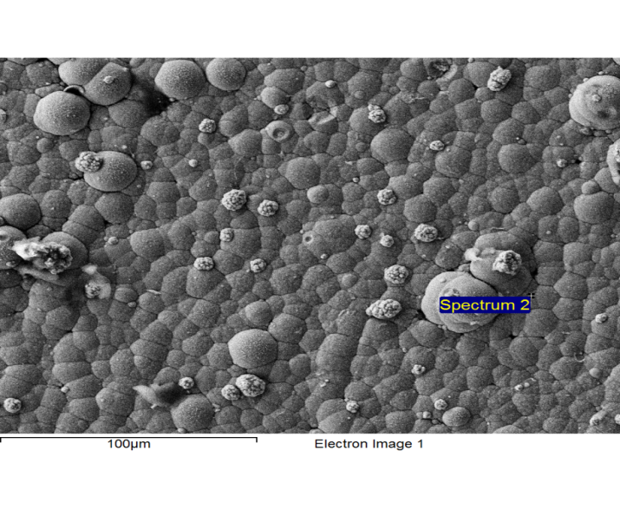
EDS Analysis : Ni-B-W-hBN
Element | Weight% | Atomic%
C K | 23.54 | 58.62
N K | 2.16 | 4.61
Ni K | 71.34 | 36.34
W M | 0.13 | 0.02
Pb M | 2.83 | 0.41
Total | 100

Slide 29
Possible Scratch Combinations
Sr.No | Compositions | Load(N) | Sratch Speed(mm/s)
1 | Ni B | 14 | 1
2 | Ni B | 17 | 1
3 | Ni B | 20 | 1
4 | Ni B | 14 | 3
5 | Ni B | 17 | 3
6 | Ni B | 20 | 3
7 | Ni B | 14 | 5
8 | Ni B | 17 | 5
9 | Ni B | 20 | 5
10 | Ni-B-W | 14 | 1
11 | Ni-B-W | 17 | 1
12 | Ni-B-W | 20 | 1
13 | Ni-B-W | 14 | 3

Slide 30
Possible Scratch Combinations
Contd from previous page…
13 | Ni-B-W | 14 | 3
14 | Ni-B-W | 17 | 3
15 | Ni-B-W | 20 | 3
16 | Ni-B-W | 14 | 5
17 | Ni-B-W | 17 | 5
18 | Ni-B-W | 20 | 5
19 | Ni-B-W-hBN | 14 | 1
20 | Ni-B-W-hBN | 17 | 1
21 | Ni-B-W-hBN | 20 | 1
22 | Ni-B-W-hBN | 14 | 3
23 | Ni-B-W-hBN | 17 | 3
24 | Ni-B-W-hBN | 20 | 3
25 | Ni-B-W-hBN | 14 | 5
26 | Ni-B-W-hBN | 17 | 5
27 | Ni-B-W-hBN | 20 | 5

Slide 31
Lubricants:
Liquid Lubricants
Solid Lubricants

Slide 32
Coatings for High Temperature Lubrication
Coatings | Method of coating | Lubricant Phases | Provide lubrication upto | Ref
CrN-Ag coating | Magnetron sputtering | Ag | 600°C | [1]
CrN /Mo₂N multilayer | Magnetron sputtering | Due to oxidation of MoO₃ | 400-600°C | [2]
Yttria-stabilized zirconia (YSZ) nanocomposite coatings | Magnetron sputtering and pulsed laser hybrid mode | Ag | 700°C | [3]
TiN Coating | Magnetron sputtering | Magneli phases of Ti oxides | 700°C | [4]
VN coating | Magnetron sputtering | Magneli phases of vanadium oxides | 700°C | [4]
In625-Cr₂O₃-Ag coatings | Cold spraying | Ag | 1000°C | [5]
Contd…
Notes:
Table

Slide 33
Coatings for High Temperature Lubrication
Contd from previous page…
Coatings | Method of coating | Lubricant Phases | Provide lubrication upto | Ref
Cu-Mo coating | Ion beam deposited | Oxide phases CuMoO₄ and MoO₃ | 530°C | [6]
aromatic thermosetting polyester (ATSP) coating | electrostatic spray deposition (ESD) | PTFE | 300°C | [7]
nano-Cu/h-BN/Ni60 | Laser cladding | hBN | 600 | [8]

Slide 34
Working Temperature of Solid Lubricants
Solid Lubricants | Working Temperature Range | Ref.
Graphite | 500°C | [9]
Molybdenum Disulﬁde (MoS₂) | 300 °C | [10]
Tungsten Disulﬁde (WS₂) | 540°C | [11]
Hexagonal Boron Nitride (hBN) | 1000°C | [12]
Decomposition of solid lubricants
Notes:
hBN is the best
Next level of our work
Cite more references
Phases generated after decomposition (mention at least 2-3) … Purpose of using solid lubricant not fulfilled at that temperate and beyond

Slide 35
Application of hBN in Tribological Coatings
Coating | Solid Lubricants | Process of Coating Fabrication | Ref.
Nano -Cu/h-BN/Ni60 | hBN | Laser Cladding | [13]
TiB2–TiN–SiC-hBN |  | Laser Assisted Processing | [14]
Ni-B- hBN |  | Electro Deposition | [15]
Ni-P- hBN |  | Electroless Depositon | [16]

Slide 36
Popular Electroless Tribological Coatings
Ni [19], Ni-P [20], Ni-B [21] etc.
Electroless Ni-B based coatings are superior in terms of:
Hardness
Wear resistance [21]
Strengthening by Alloy and Composite Formation
Ni-B [21]
Ni-B-W [22]
Ni-B-Mo [23]
Ni-B-Co [24] etc.
Ni-B-W [22]
Ni-B-SiC [25]
Ni-B-W-SiC [26]
Ni-B-Al₂O₃ [27] etc.
Notes:
Ni-B coatings are much superior to most common electroless Ni-P and pure Ni coatings in terms of their superior characteristics features, namely hardness, frictional behavior and resistance to wear and corrosion.
Ni-P based or Ni-B based coatings

Slide 37
Ni-B-hBN Ni-P-hBN
High temperature tribological characterization of Electroless Ni-B-hBN
Ni-B-hBN
Ni-B-W-hBN
Notes:
From literature survey I have understood that incorporation of another hard reinforcing phase along with hBN can help me to improve mechanical and tribological properties further.

Slide 38
Now I am in position to judge the effectiveness of this composite coating, at higher temperature in two ways one by Ex-situ heat treatment and other by in-situ heat treatment testing and I will do comparison at both situation.

Slide 39
Constituents | Concentration
Nickel Chloride (Source of nickel) | 20 g/l
Sodium Hydroxide (Buffering Agent ) | 40 g/l
Sodium Borohydride (Reducing Agent) | 0.8 g/l
Sodium Tungstate (source of W) | 25 g/l
Ethylenediamine (Complexing Agent) | 59 g/l
Lead Nitrate (Stablizer) | 0.0175 g/l
hBN particles | 1 g/l

Slide 40
Component of Bath | Function
Metal ions | Source of metal
Reducing agents | Supply electrons to reduce the metal ions
Complexing agents | Prevent excess of free metal ions concentration
Accelerators | Accelerate the reducing agent and increase the deposition
Stabilizers | Stabilize the bath from decomposition
Buffers | Sustain the pH for long time
pH regulators | pH adjustment
Temperature | Energy for deposition
Surfactant | Lower the surface tension of a liquid and promotes the coating deposition reaction

